Slide 1


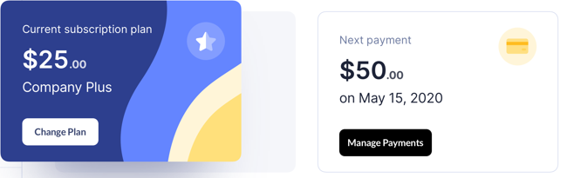
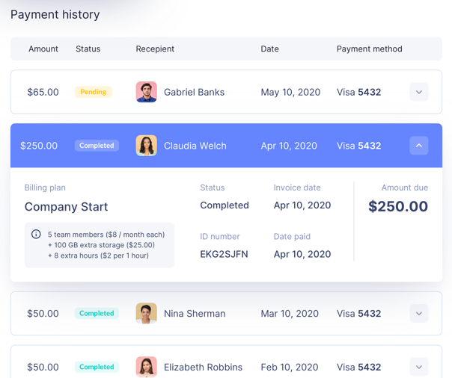
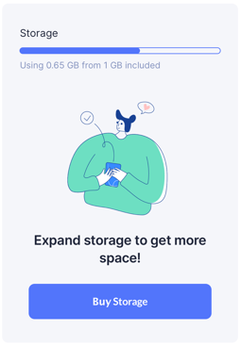
Username
Dashboard
Transactions
Account Information
Statistics
Calendar
Settings
Profile
Interface
Wallet
Notifications
Payment settings

Slide 2
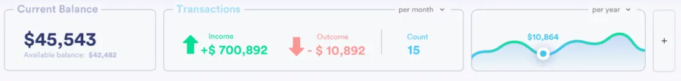
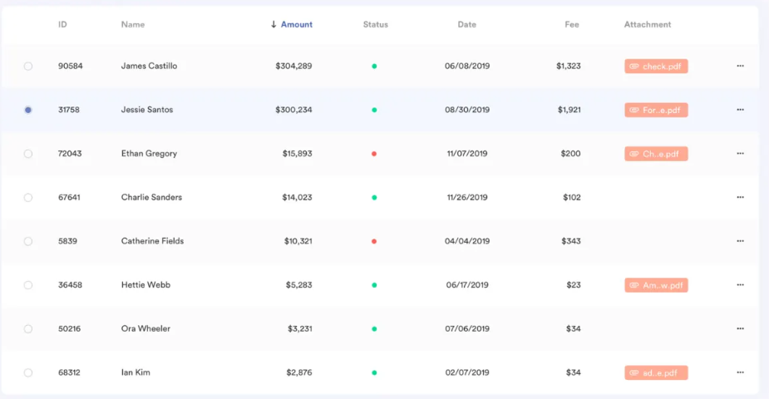
Username
Dashboard
Transactions
Account Information
Statistics
Calendar
New Transaction
Transaction form
invoices
Deposits
transfers
Settings
Profile
Interface
Wallet
Notifications
Payment settings

Slide 3
Username
Name
Phone:
Email(s):
Image:
SSN:
Card:
Dashboard
Transactions
Account Information
Statistics
Calendar
Upload
Settings
Profile
Interface
Wallet
Notifications
Payment settings

Slide 4
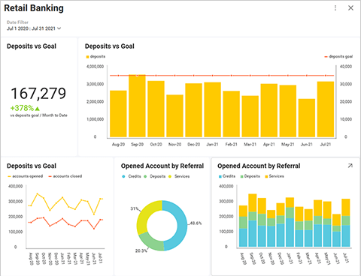
Username
Dashboard
Transactions
Account Information
Statistics
Calendar
Settings
Profile
Interface
Wallet
Notifications
Payment settings
Graphs
Pie charts
Bar graphs
Scatter plot
Account Audit
Recipient percentages
Yearly Spending

Slide 5
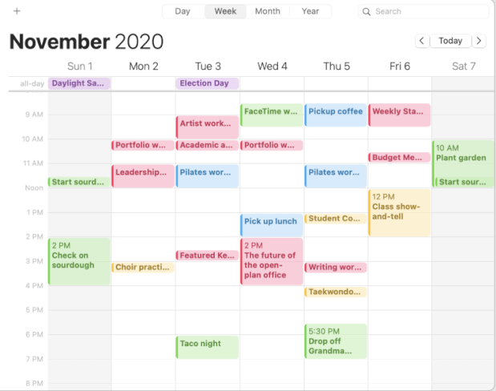
Username
Dashboard
Transactions
Account Information
Statistics
Calendar
Appointments | Payments | Payment Plans
Settings
Profile
Interface
Wallet
Notifications
Payment settings

